Slide 1
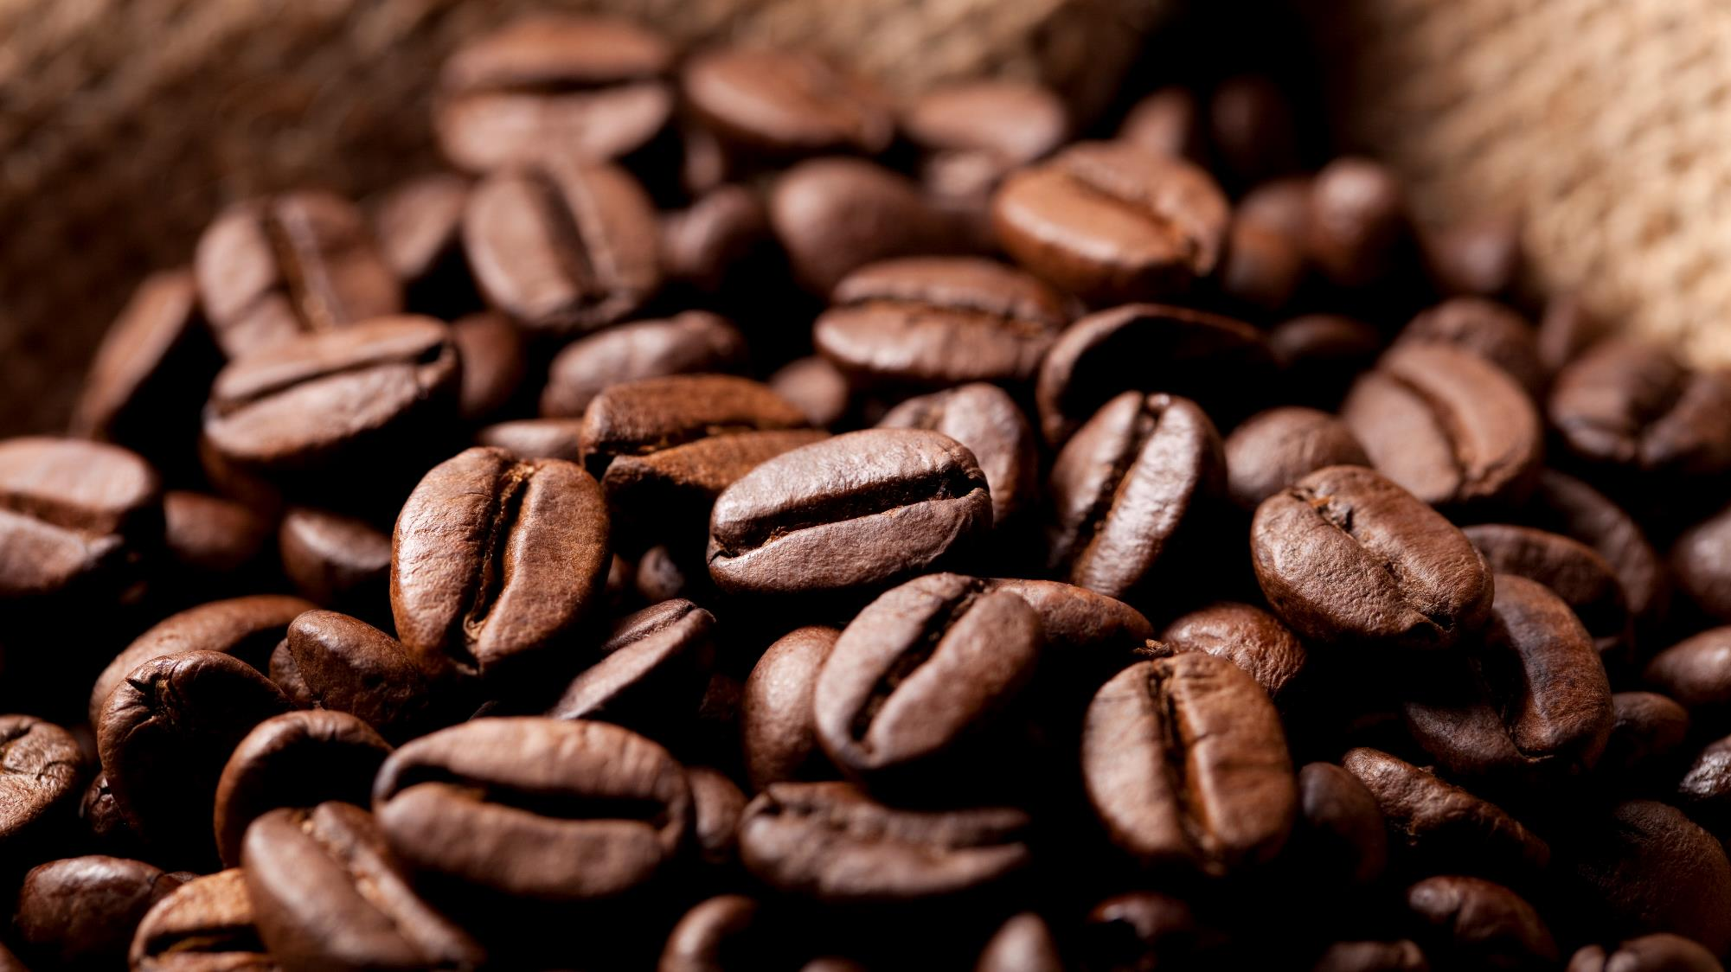

Lucky Cafe
The Krisztián nonprofit kft property

Slide 2
Client requirement
<-client
-Main page
-Coffe webpage(daily offer)
-Cookies webpage(daily offer)
-Blog
-Article

Slide 3

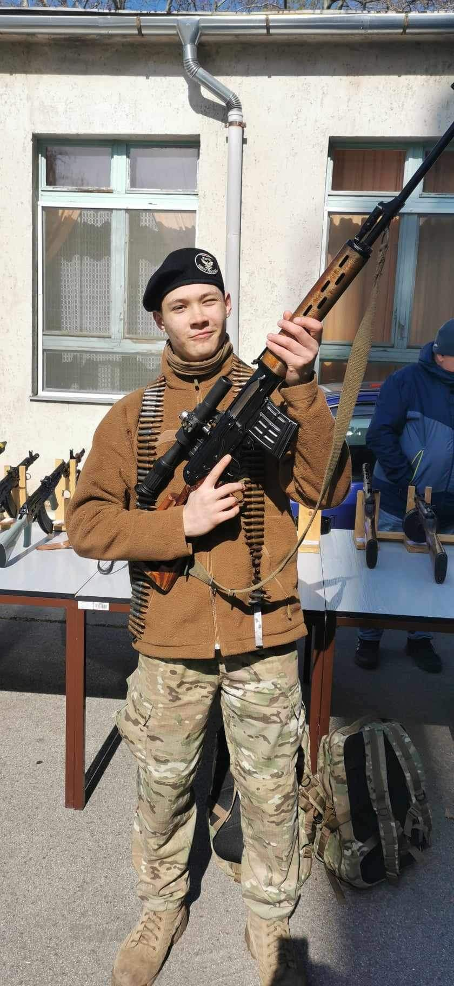
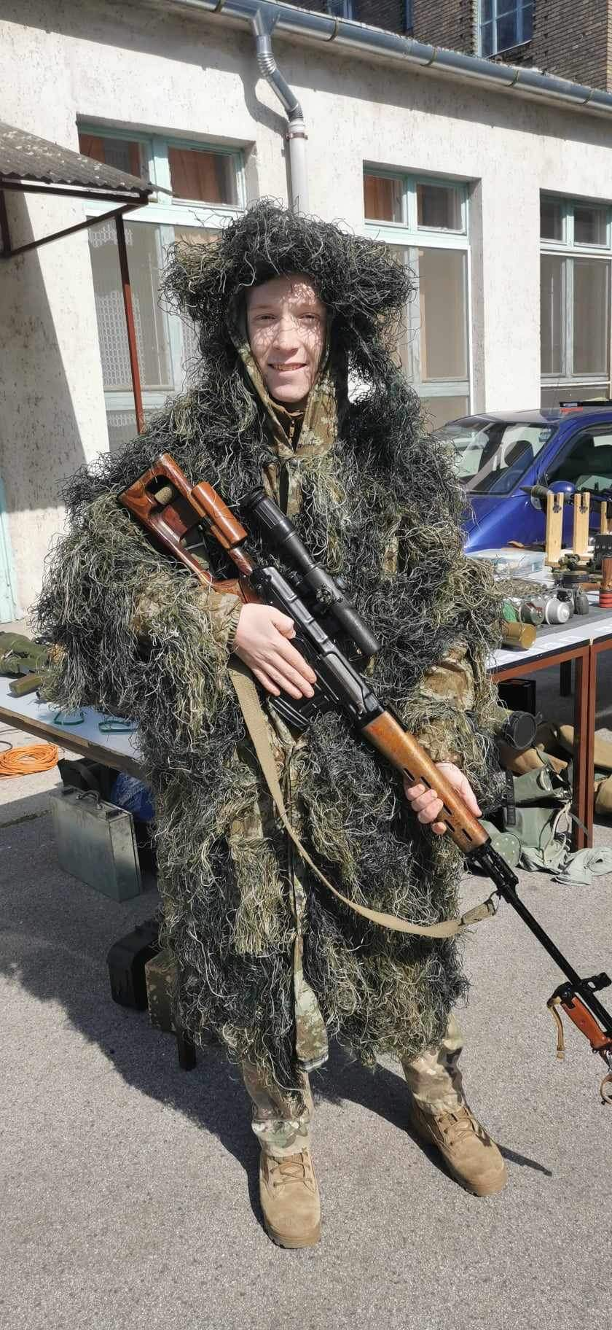
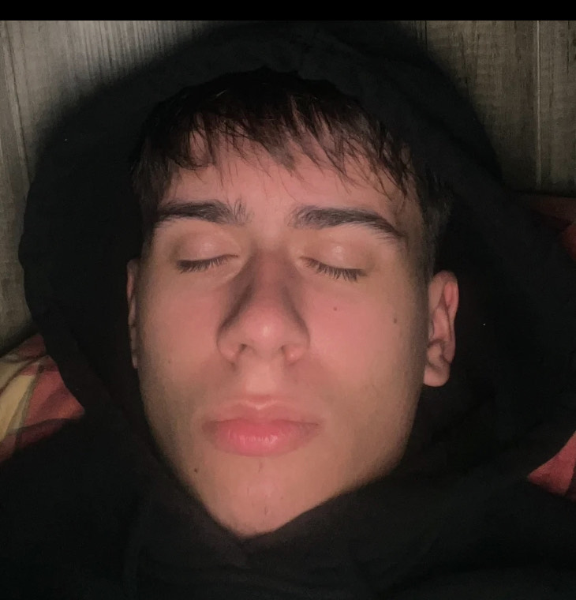
Team
Coding of the main page
Coding of cookies webpage
Coding of coffe webpage
Coding of the blog
Krisztián
Zsolt
Milán
Tibi

Slide 4
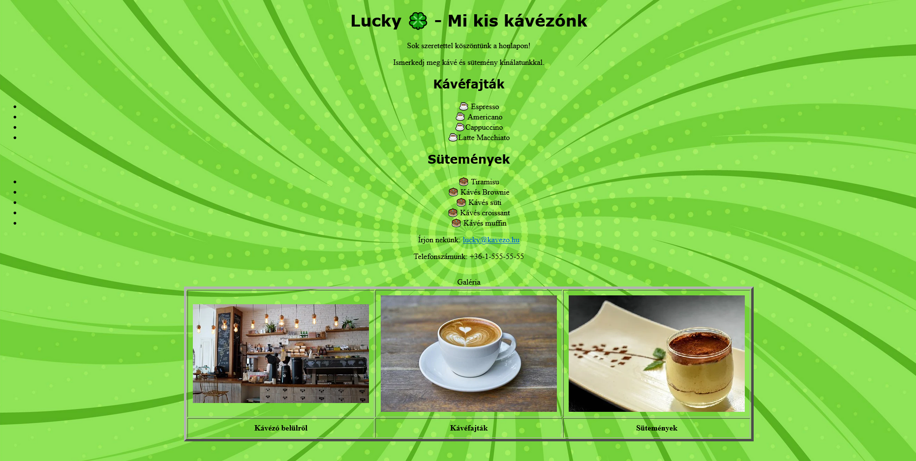
Old webpage

Slide 5
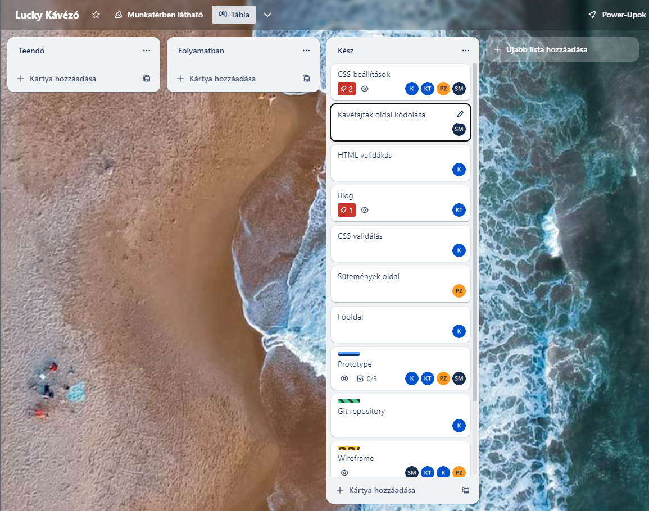
Projekt planning
CSS – everyone
Coffe page – Milán
HTML and CSS validation – Krisztián Blog page – Tibi
Cookies page – Zsolt Main page – Krisztián Git repository – Krisztián Prototype - everyone

Slide 6
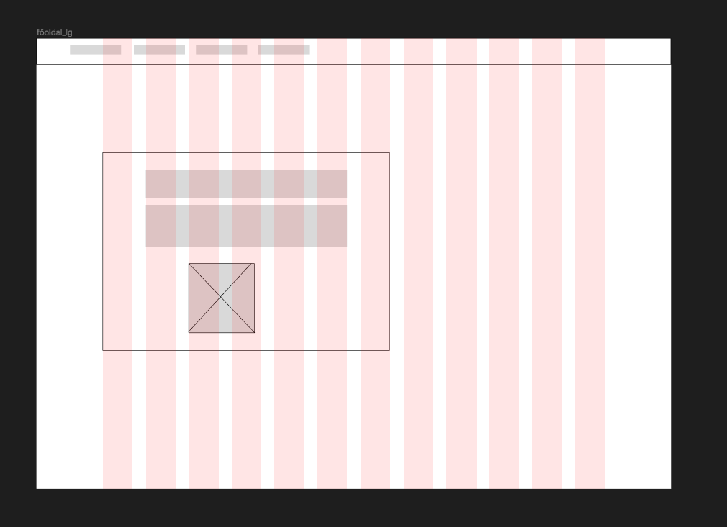
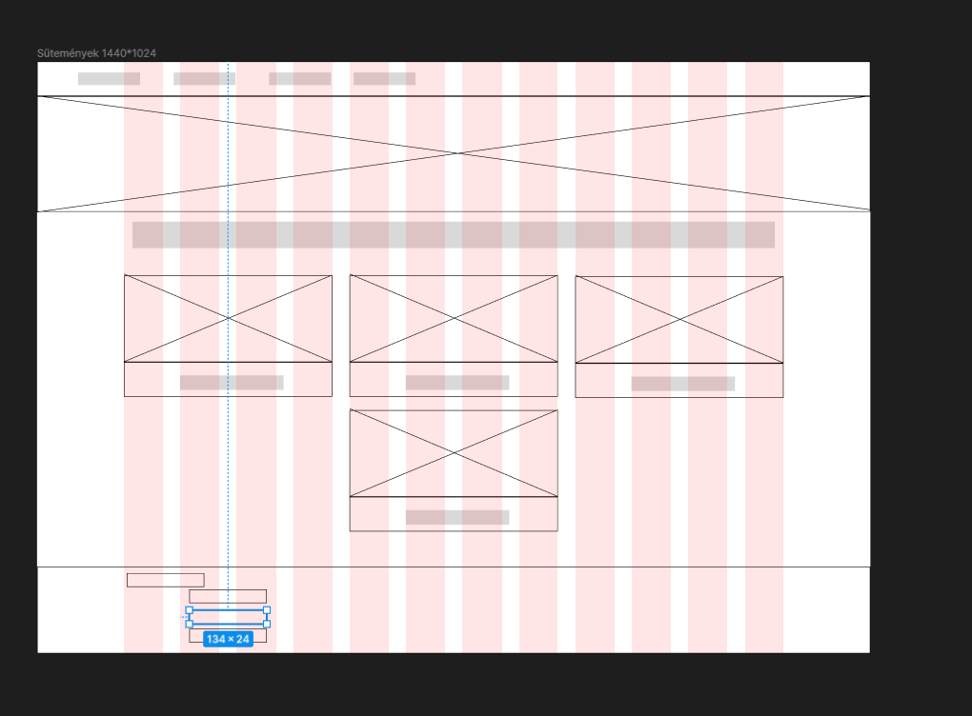
Wireframe

Slide 7
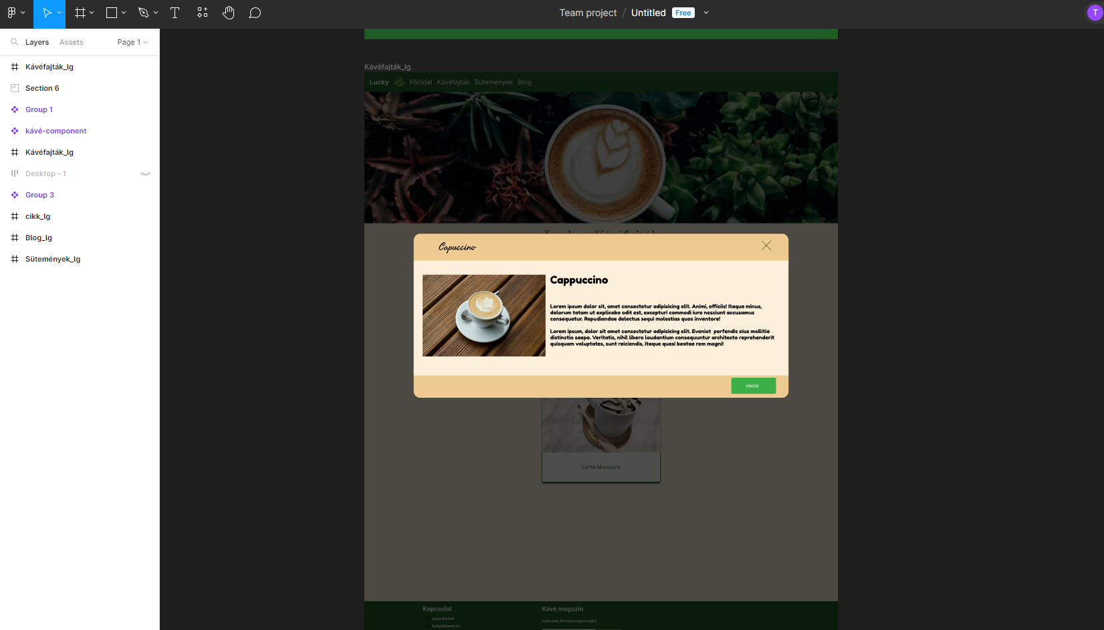
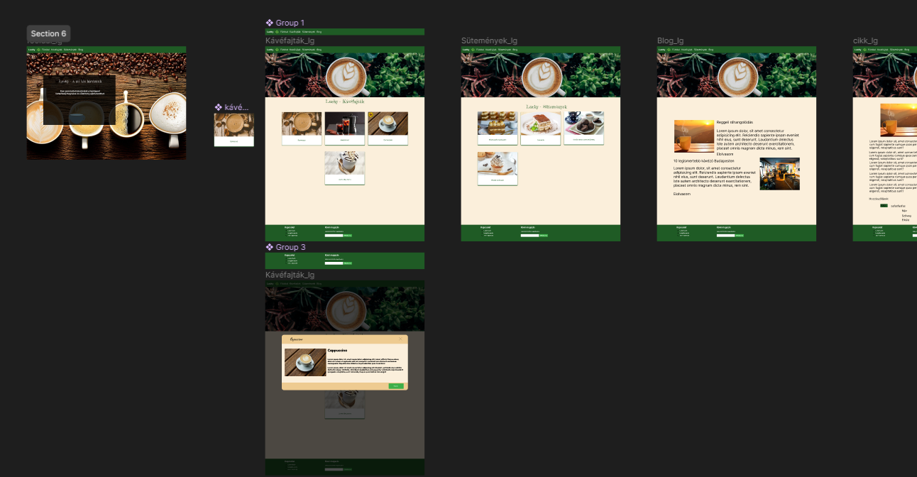
Prototype

Slide 8
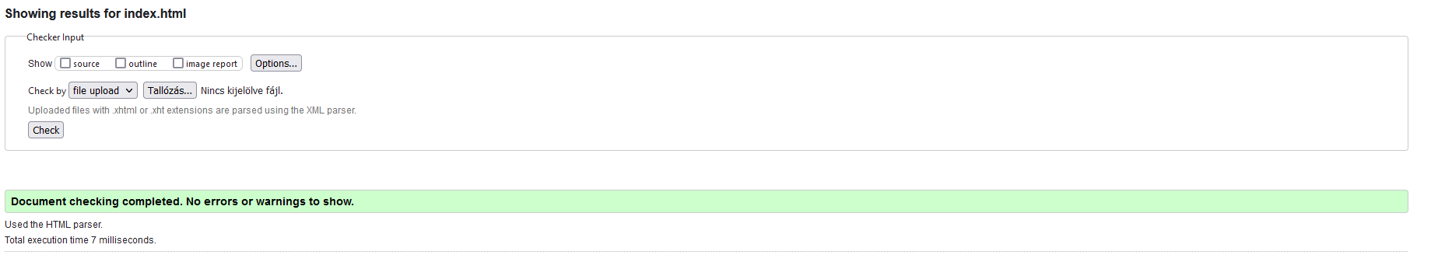
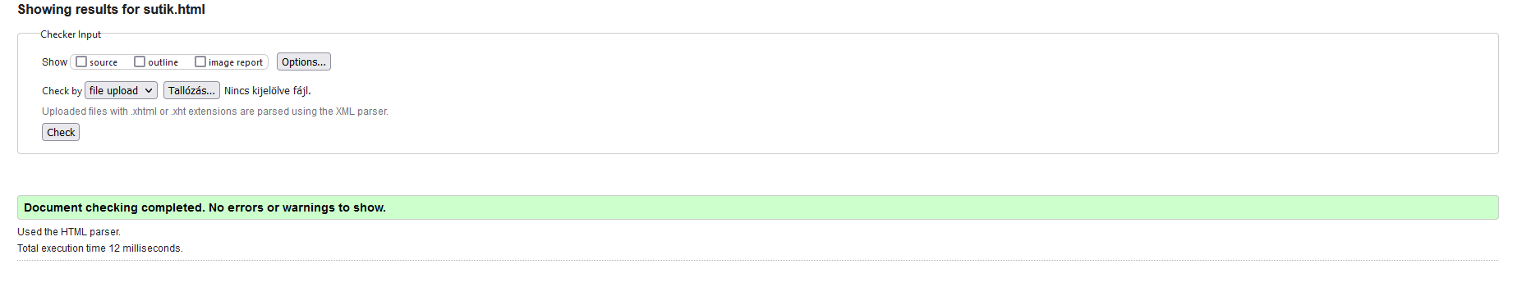
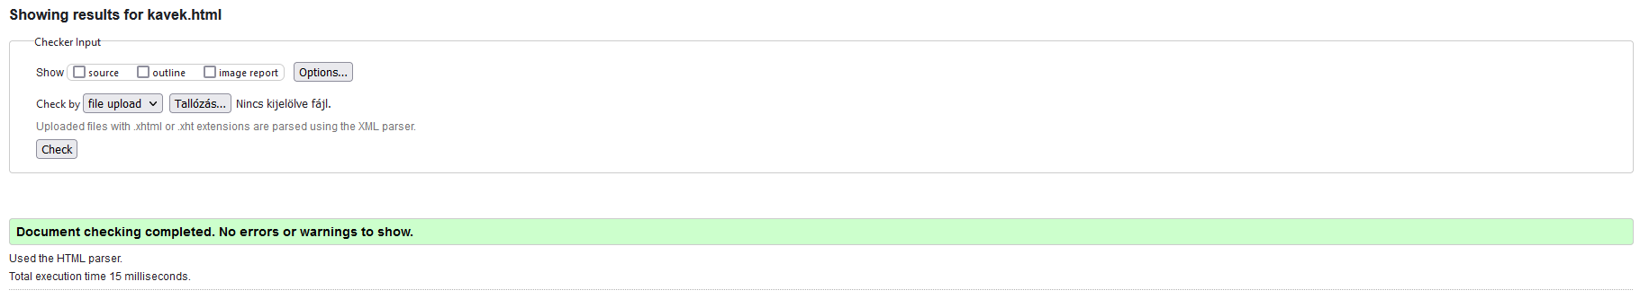
Validation

Slide 9
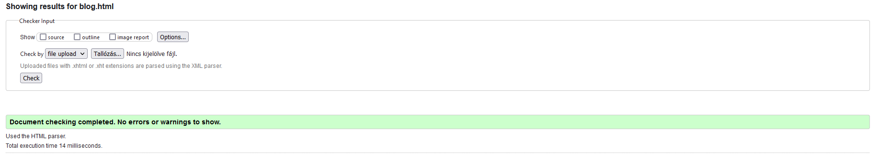
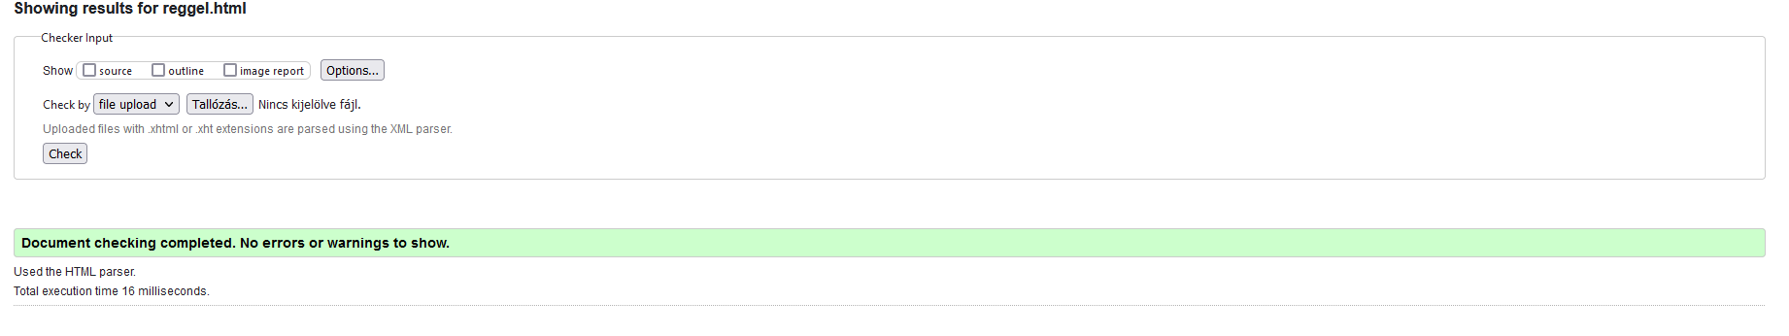
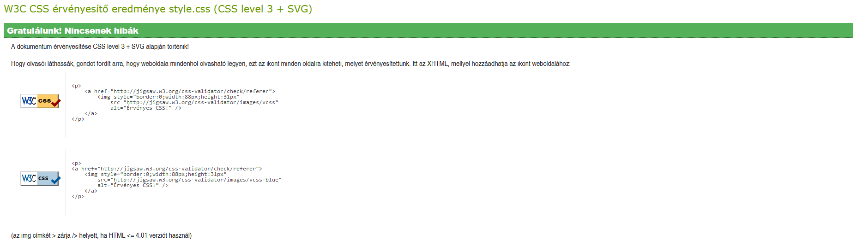

Slide 10
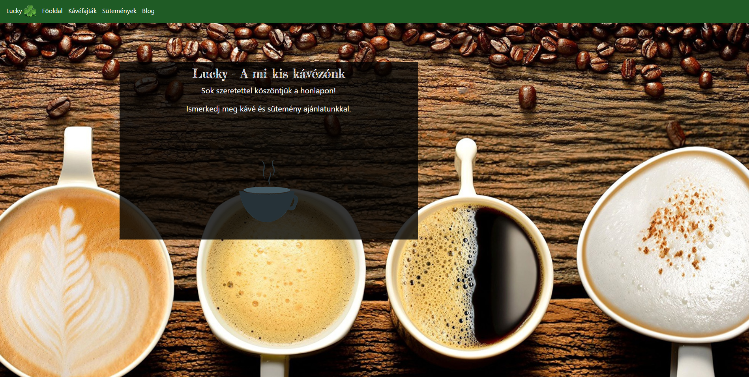
Main page

Slide 11
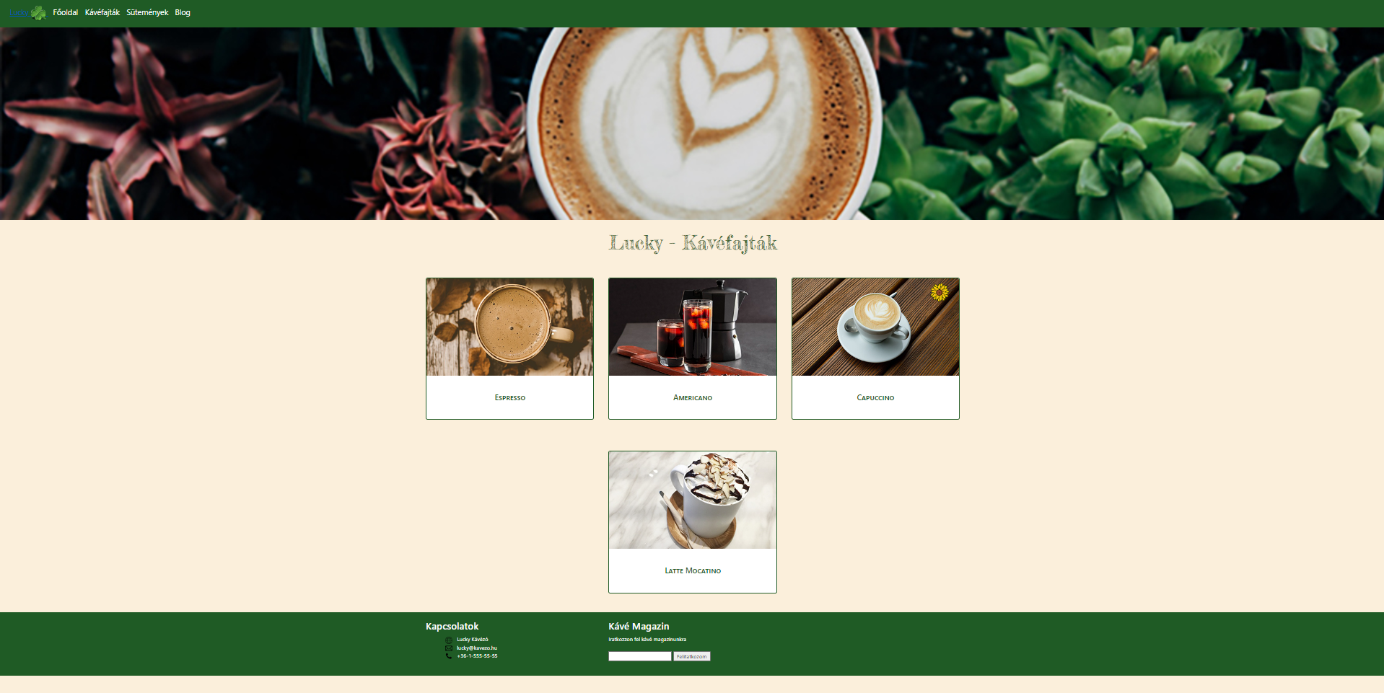
Coffe webpage

Slide 12
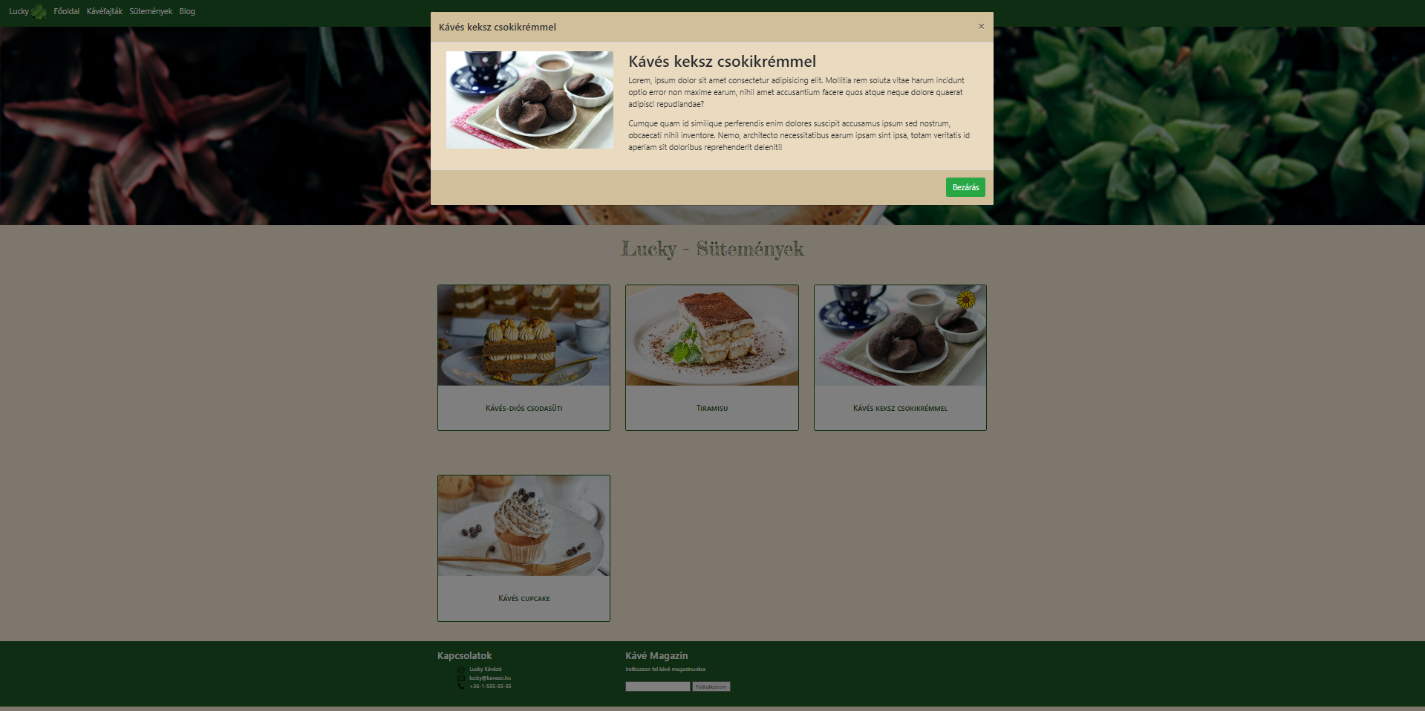
interactive interface

Slide 13
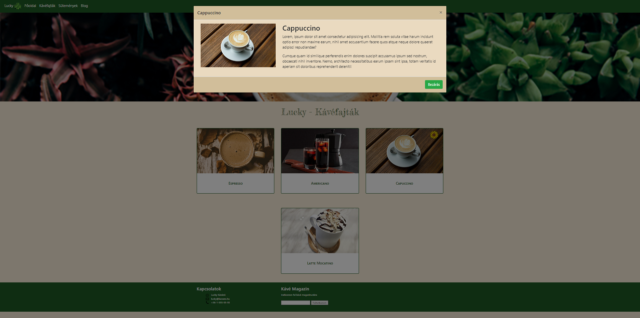

Slide 14
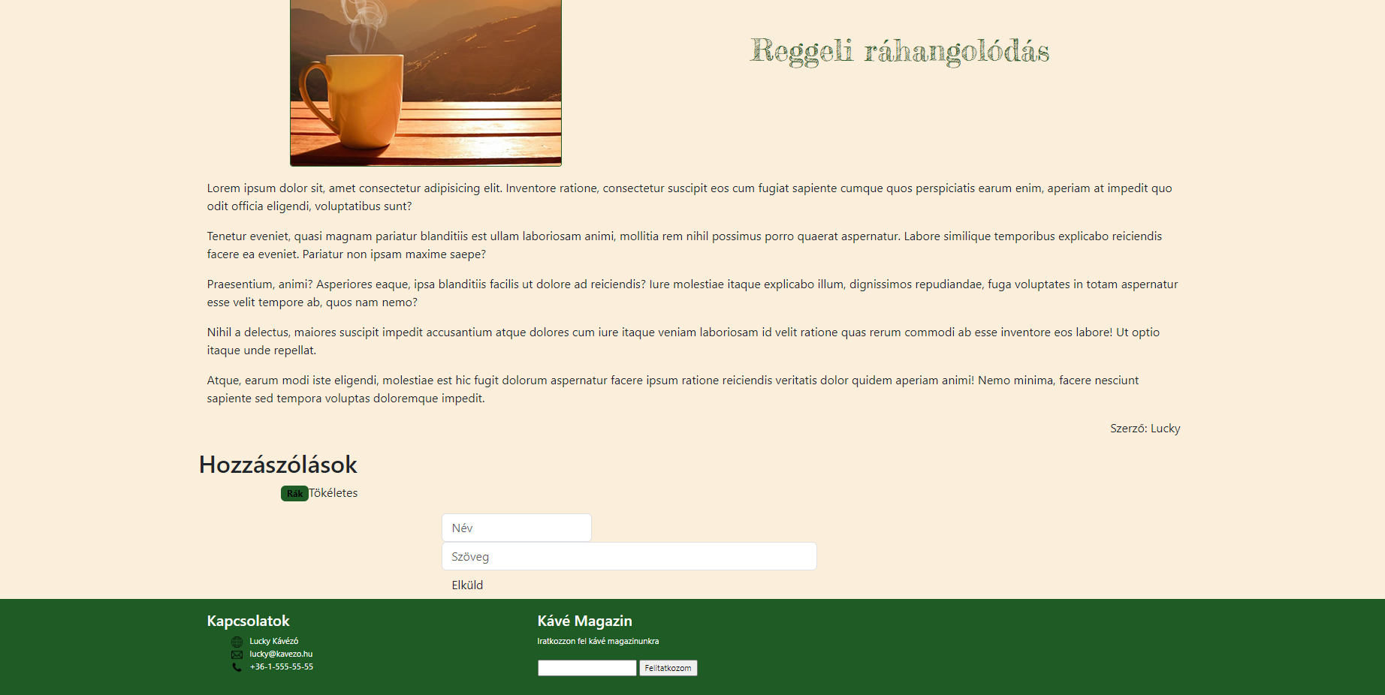
Blog webpage

Slide 15
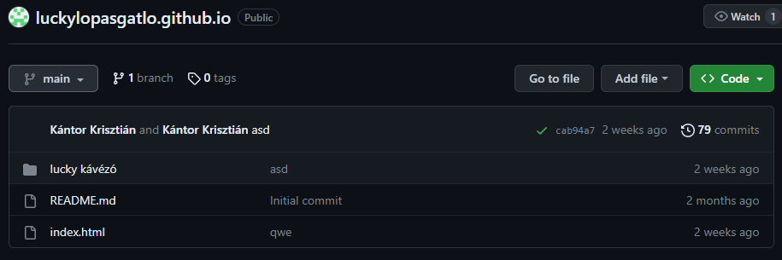
Github

Slide 16
Webpages link
https://tsikkk.github.io/luckylopasgatlo.github.io/

Slide 17
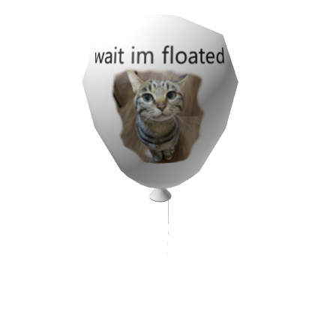
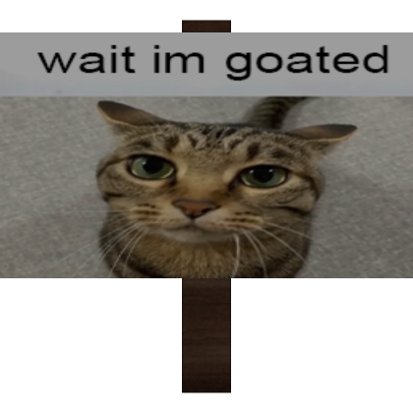
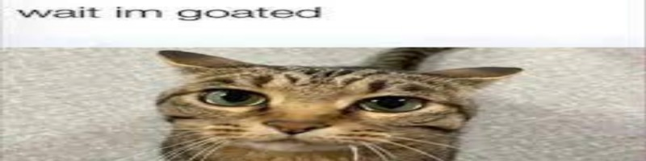

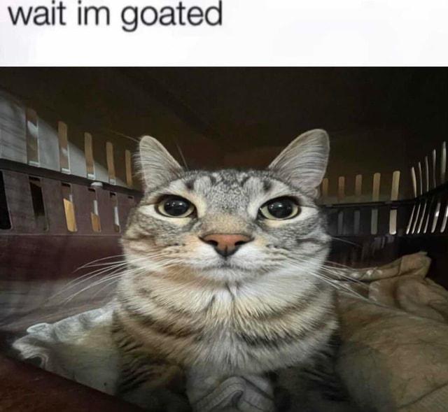

Thank you for your attention!

